Slide 1
Submitted By:
Job Matchers
Muskan Mittal (UE193075),
Nancy (UE193077),
Nischay Wadhwa (UE193083)

Slide 2
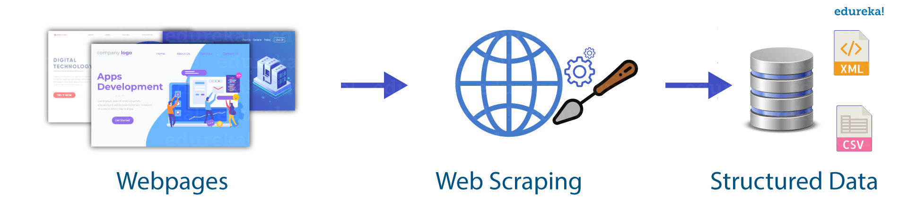

Aim and Introduction
A person who is in search of a job has to visit job opening portals everyday. Things like searching through the multiple job portals and various pages of the portal for new jobs, checking the requirements of a particular job, and the range of salary can take you around 20-30 minutes if you do it manually.
With Job Matchers we want to make the task of looking for job openings easier and reliable. So that the person can focus only on those job openings which are relevant to him/her. The person will then be provided with the details of his area of interest for the job.

Slide 3
Objective
In this project we aim to create a mobile app where a user can look for job openings in a particular field of his/her interest. The main aim is to reduce the time that gets wasted in looking on multiple pages of portals for a certain job.
Features of app:
User will simply come to the app. In search bar they will add the job role and location for a job. This will show them a list of job opportunities along with Position, Company Name, Location, Description of job and Link to apply to the job.
Users will also be notified after a particular time if there is a new job opening. This will keep them updated with new job openings time to time.
Another aim of the app is to remind them to apply to a job if deadline is near to apply to a job.

Slide 4
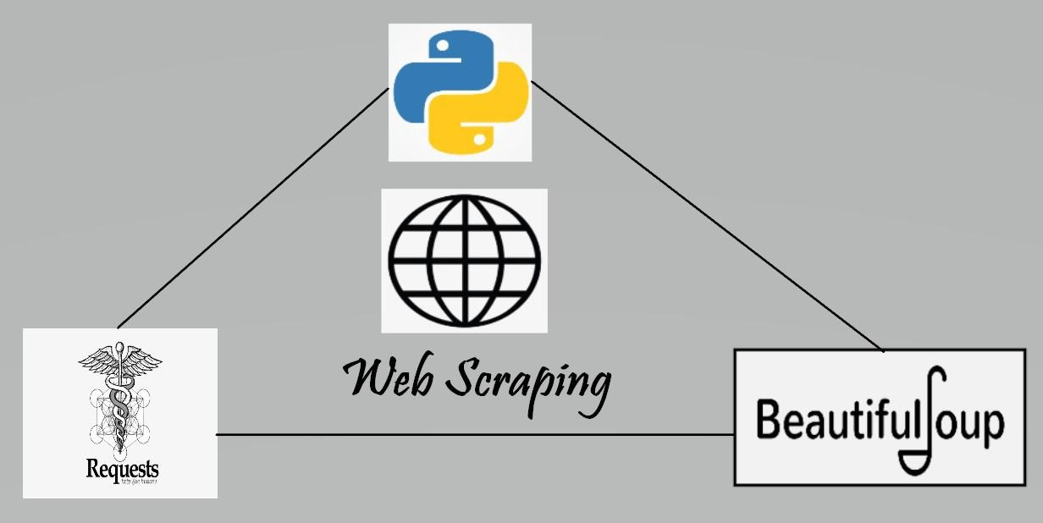



Technologies used:

Slide 5
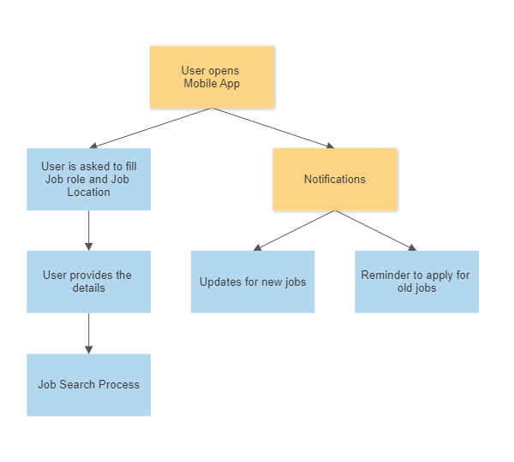
WORKFLOW

Slide 6
How does the App Works ?
We will be using the Java and XML for the android . For the user interface we will be using ListView and ArrayAdapter. Each job will contain the attributes like job title, company name , job description and url . By clicking each job, the new intent will be created and job page will be open . Two fields will be provided for input for location and the position, so according to that particular location and position the jobs will be displayed to the user . At the backend the call to API will be made after regular time intervals so new jobs added to the data source will also be displayed in the app.
The features like sending the notifications of the new job openings and also notifications regarding deadline of the particular job will also be there.

Slide 7
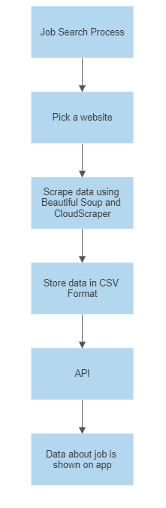

Slide 8
We have used beautiful soup library of python to scrape data. Also, indeed.com doesn’t allow to scrape data from its site so we have used cloudscraper which is used to scrape or crawl a website protected with Cloudflare.
Web Scraping
Firstly we import necessary libraries like requests, pandas, beautiful soup, cloudscraper.
We create a method that takes position and location as input and returns the link to site whose data needs to be scrapped.
The above link has long list of results in the form of pagination. So we store the links of pages in a list.
Now we go to each link and try to extract information like company_name, location, position, description and link to apply for that job.
Using the inspect option in the web browser, we find the the tags and classes of above attributes and using beautiful soup we extract these data in list.
Then we create a dictionary of above list and then convert it into dataframe and then export this dataframe to csv format.
Link to Code

Slide 9
Thankyou!

